Slide 1
Clustering molecular dynamics trajectories
Jacob Wesley Dell
Chem 96 (Robustelli)
8 March 2022

Slide 2
Background
Dimensionality reduction for probability distributions
Makes large datasets manageable/meaningful
Useful in MD to find metastable states and study reactive conformations

Slide 3
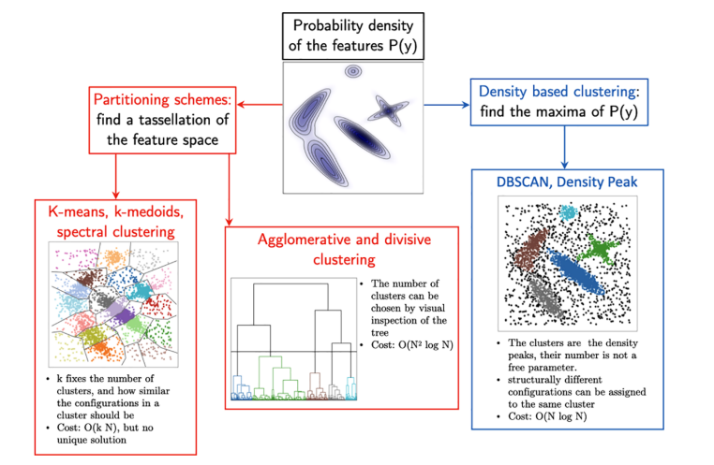
Background (cont’d)

Slide 4
Popular approaches and algorithms
K-means
Hierarchical (agglomerative/divisive)
Density-based (DBSCAN)
Probability density/free energy surface vs. dendrogram
Others (not as helpful for protein dynamics)

Slide 5
Implementation and packages
PyPI
scikit-learn
Chimera/VMD/Gromacs/AMBER (CPPTRAJ)
Gromacs/CHARMM/NAMD/AMBER/PDB/DNA/RNA via SciPy → TTClust
SciPy → MDTraj

Slide 6
Application: IDPs
Via Prof Robustelli (also seen in Tommy’s pres): N_{TAIL} α-MoRE C-terminal domain of the measles virus nucleoprotein apo ensemble (residues 484–504) 100 µs @ 300K
Stride of 10 (downsampled from ~120000 frames to around 12000)

Slide 7
Results thus far (similar approaches)
TTClust
K-means “elbow” clustering
~30min on local machine (bottleneck: distance matrix computation)
Automatic selection of 5 clusters
Output: plots, text file with frame IDs, RMSD values, representative frame PDBs
MDTraj
Ward agglomerative hierarchical clustering
~30 min on local machine via Jupyter Notebook (bottlenecks: cluster linkage and assigning cluster identities to frames)
Manual stipulation to create 5 clusters
Output: array with cluster labels for every frame, single PDB with all representative frames

Slide 8
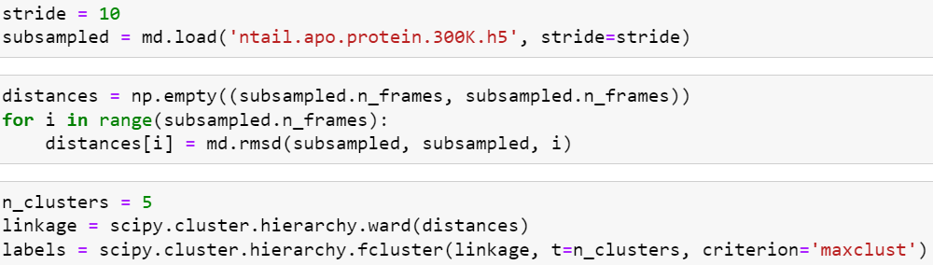
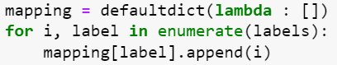
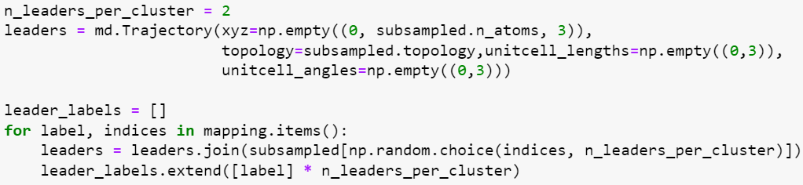
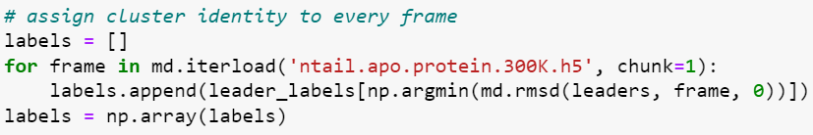
MDTraj code walkthrough
*
*

Slide 9
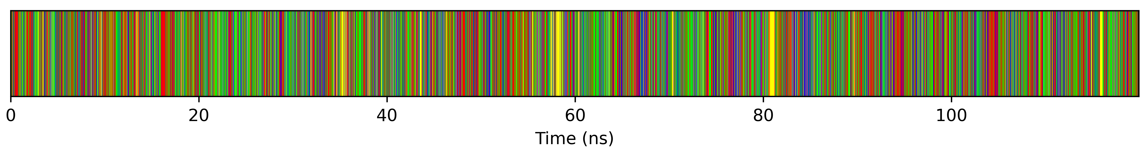
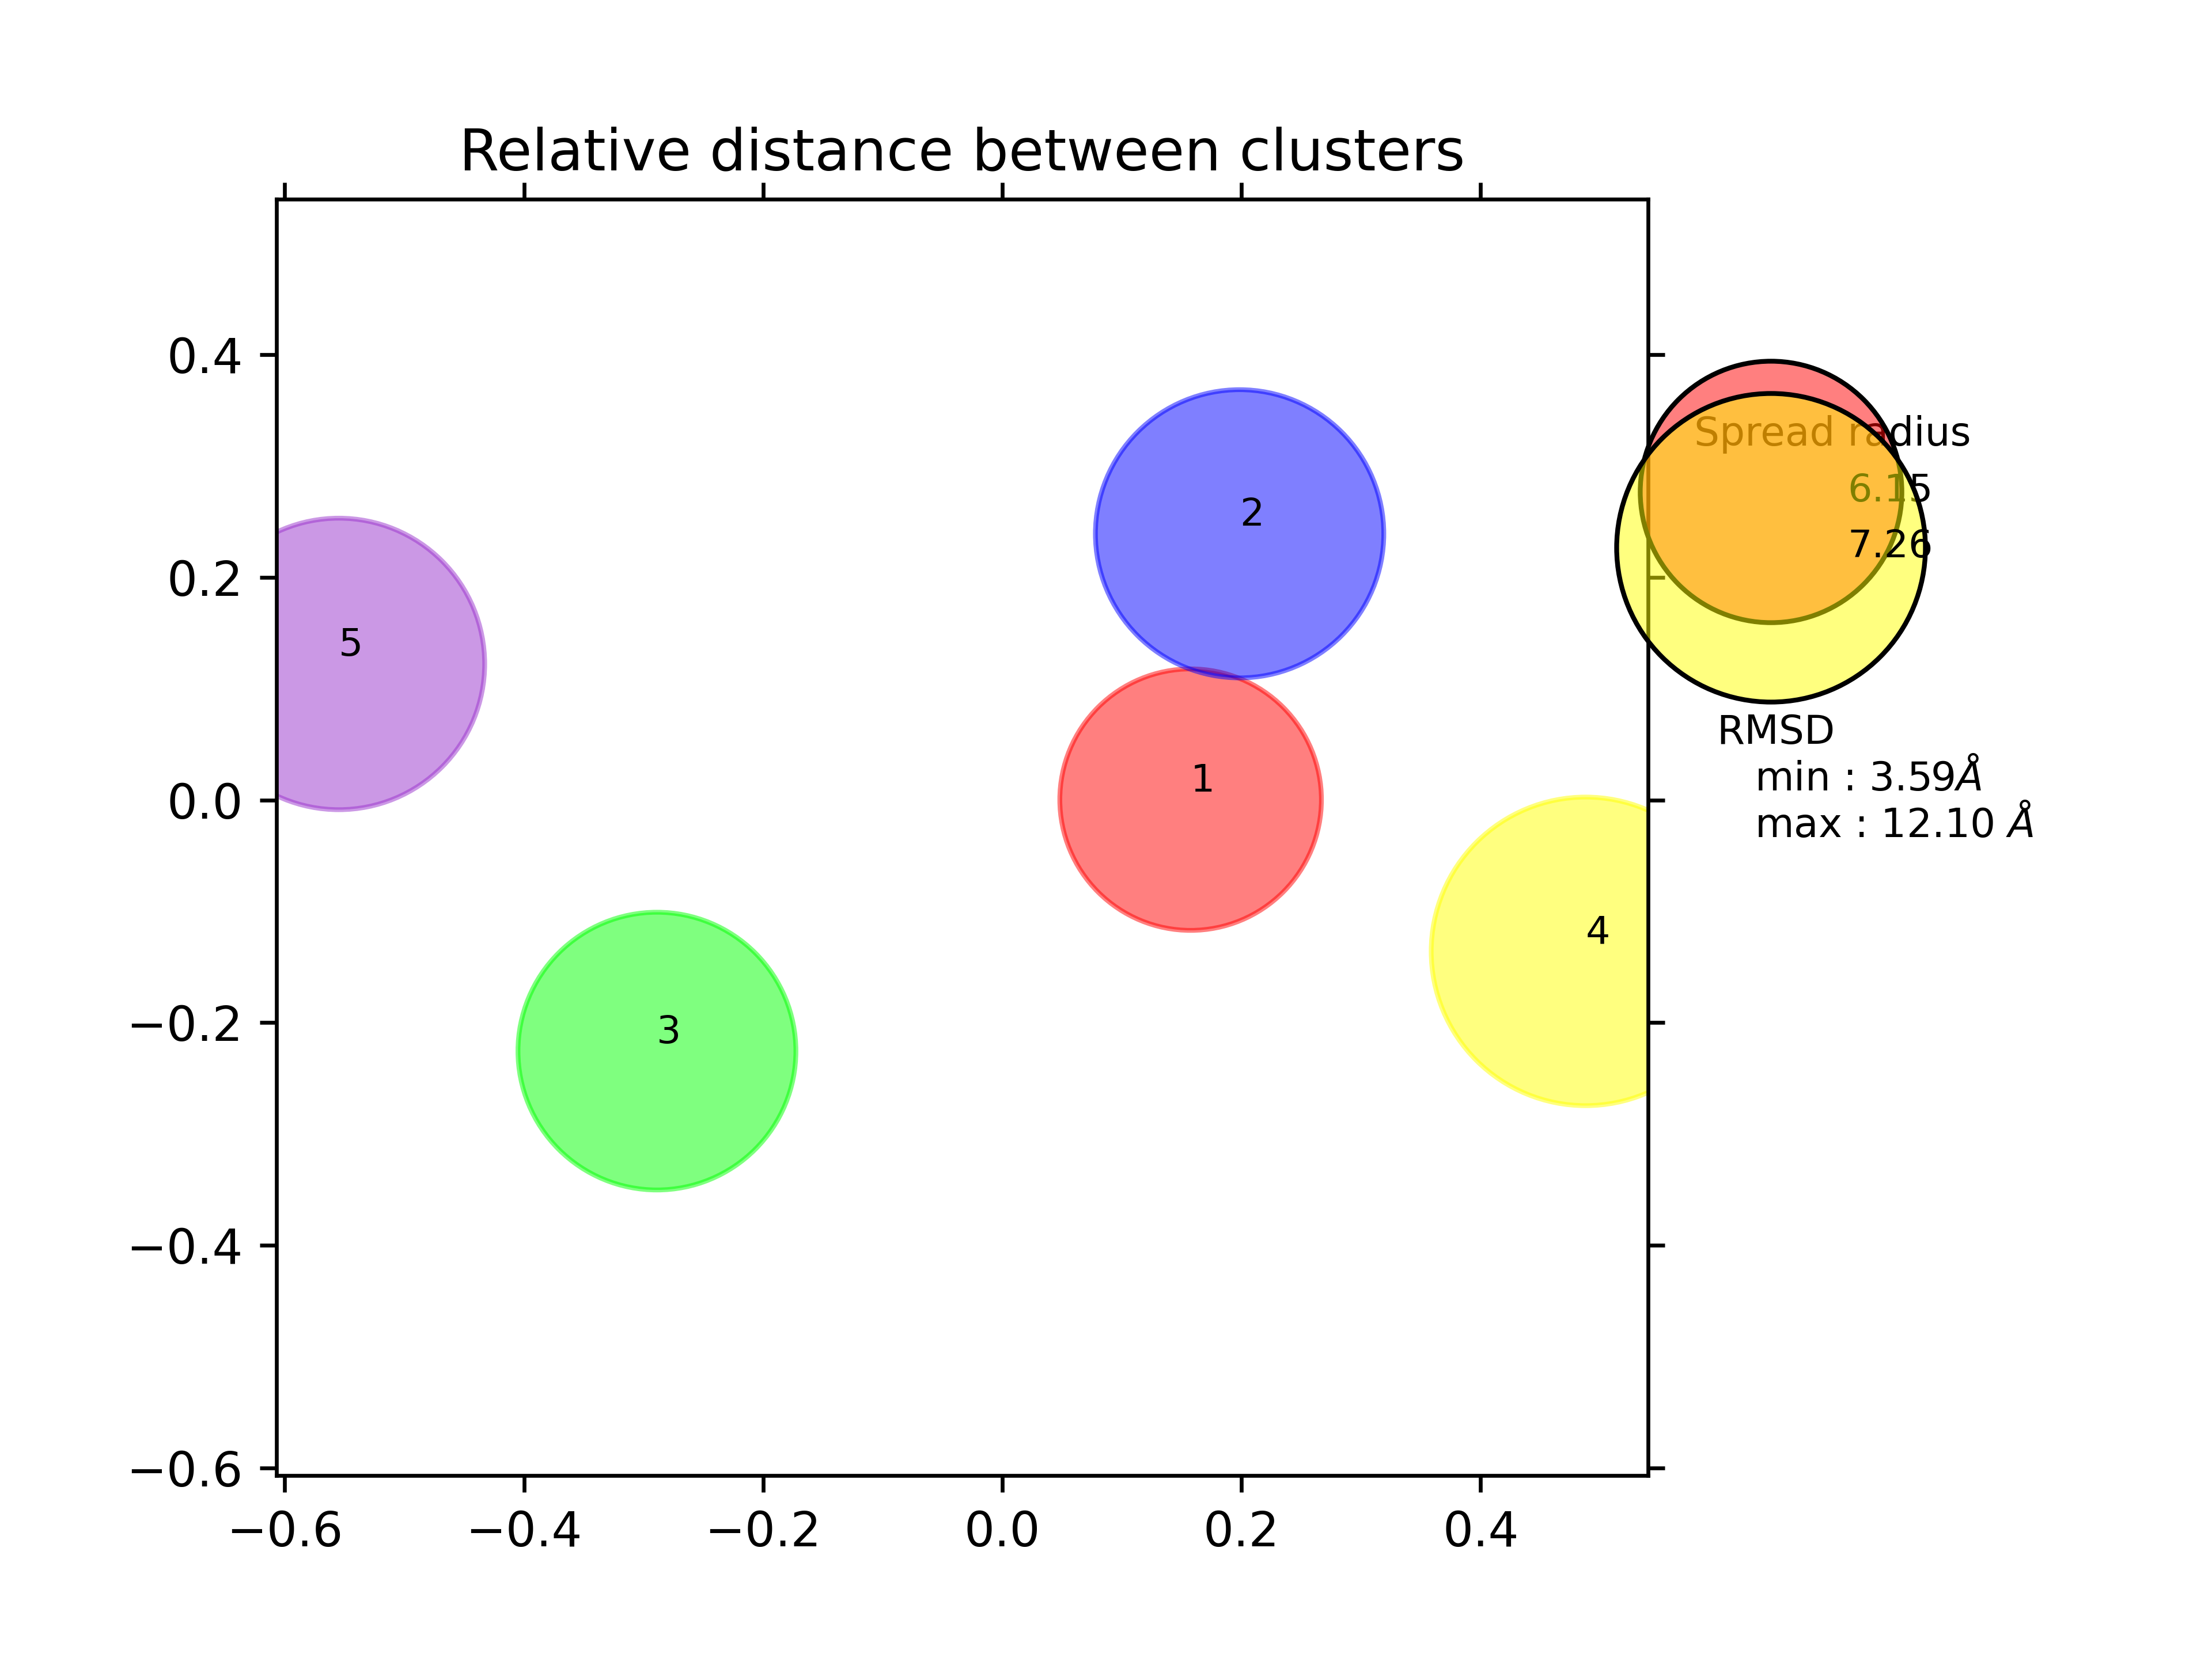
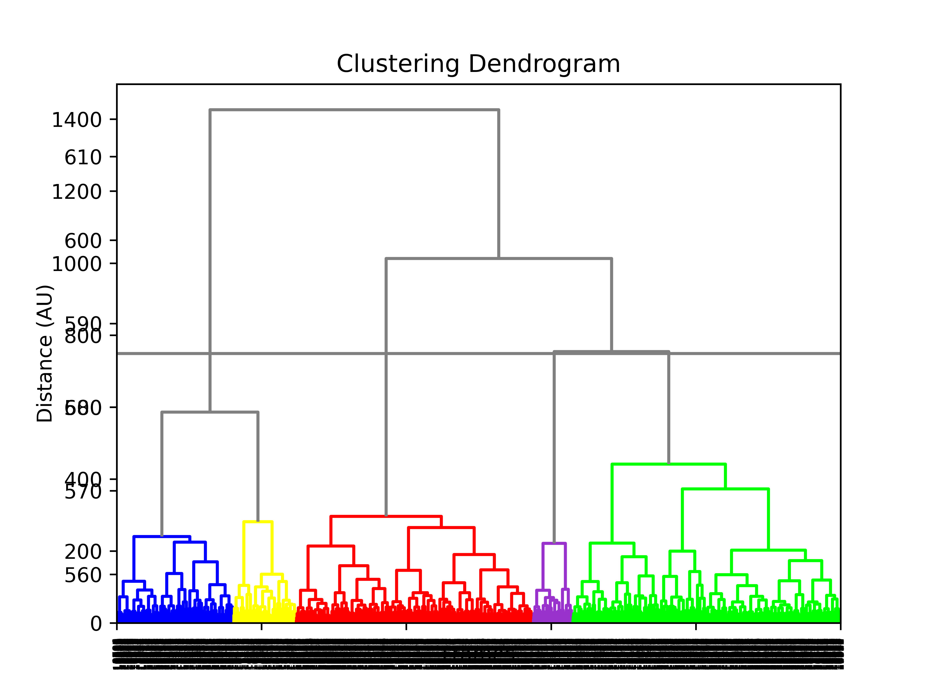
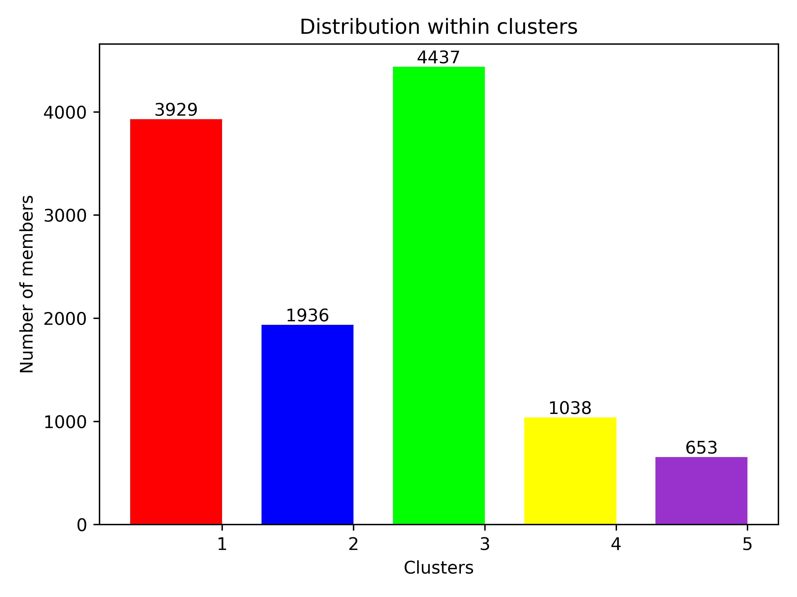
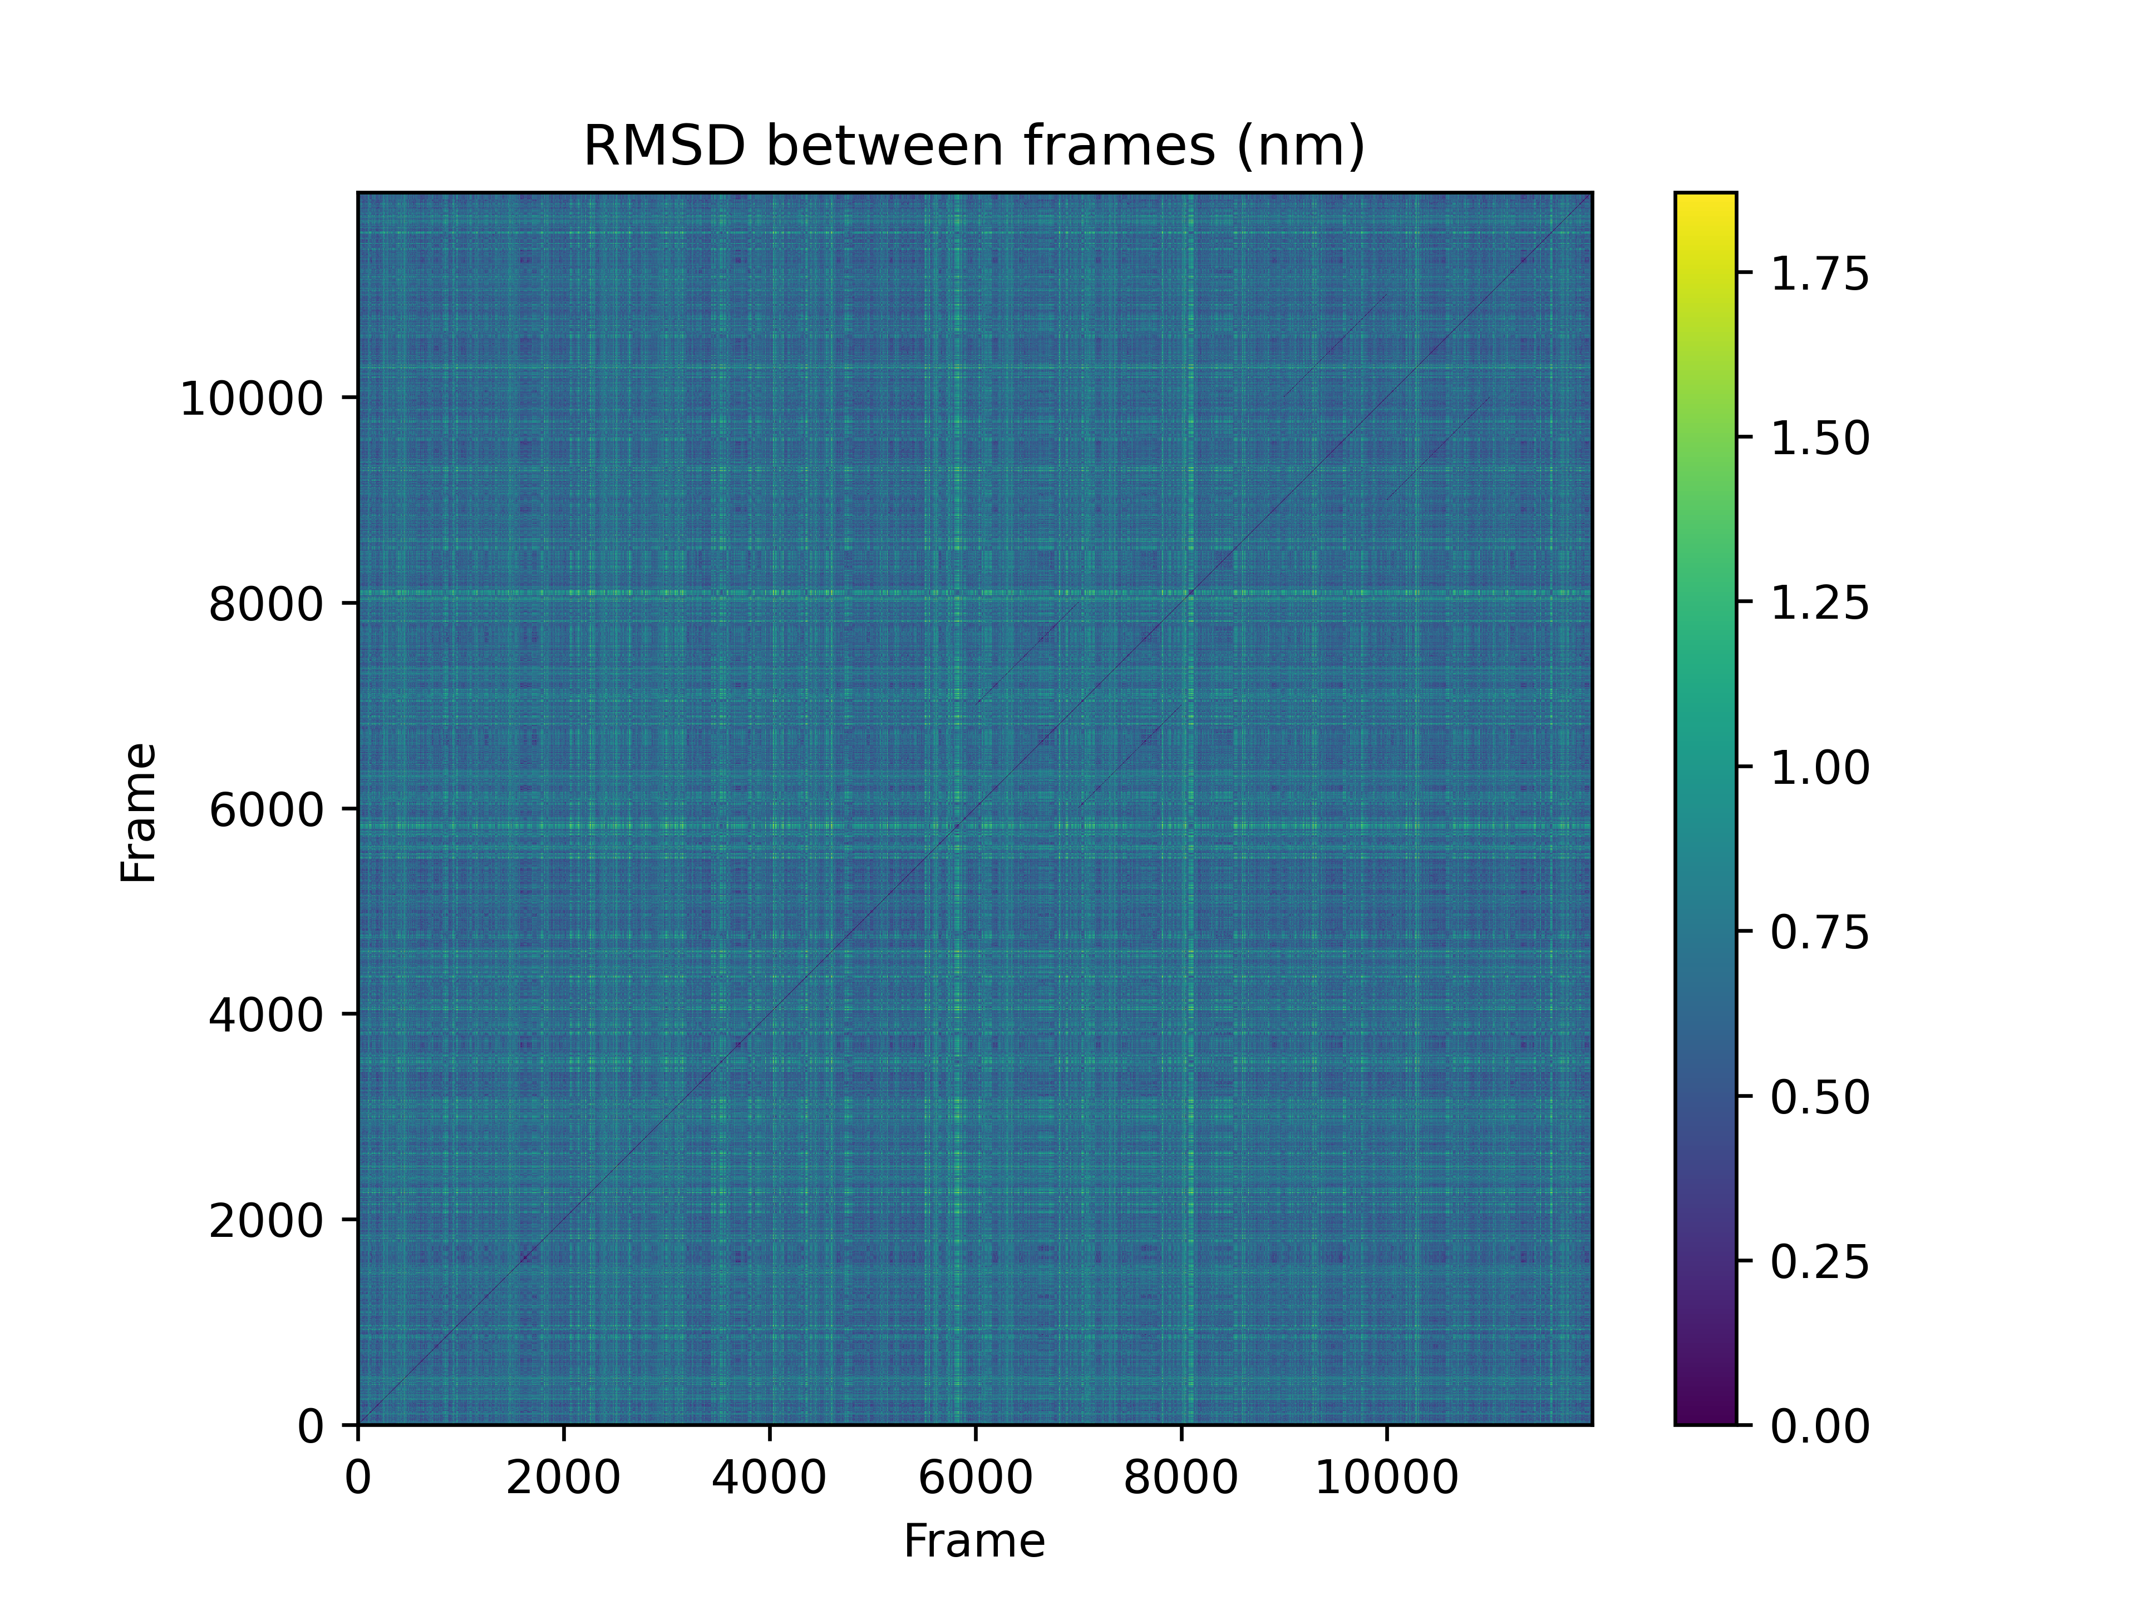
TTClust results
RMSD between clusters
cluster | 1 | 2 | 3 | 4 | 5
1 | 0 | 3.595 | 6.957 | 5.398 | 9.188
2 | 3.595 | 0 | 7.264 | 5.726 | 9.734
3 | 6.957 | 7.264 | 0 | 9.283 | 5.296
4 | 5.398 | 5.726 | 9.283 | 0 | 1.21
5 | 9.188 | 9.734 | 5.296 | 1.21 | 0

Slide 10
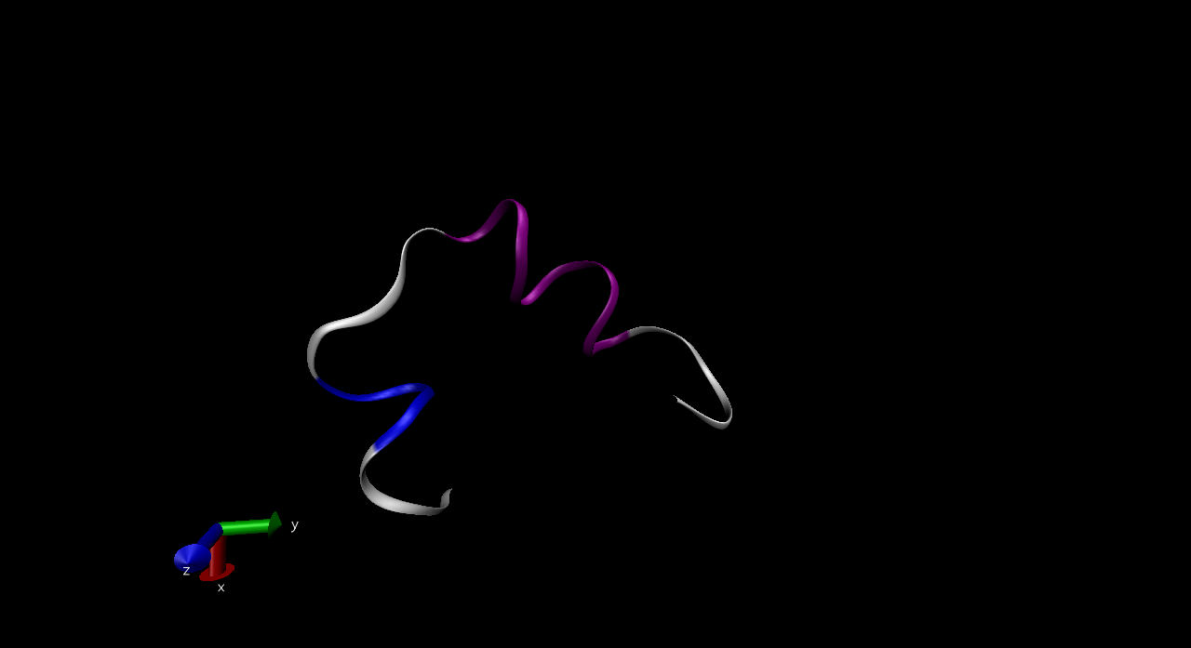
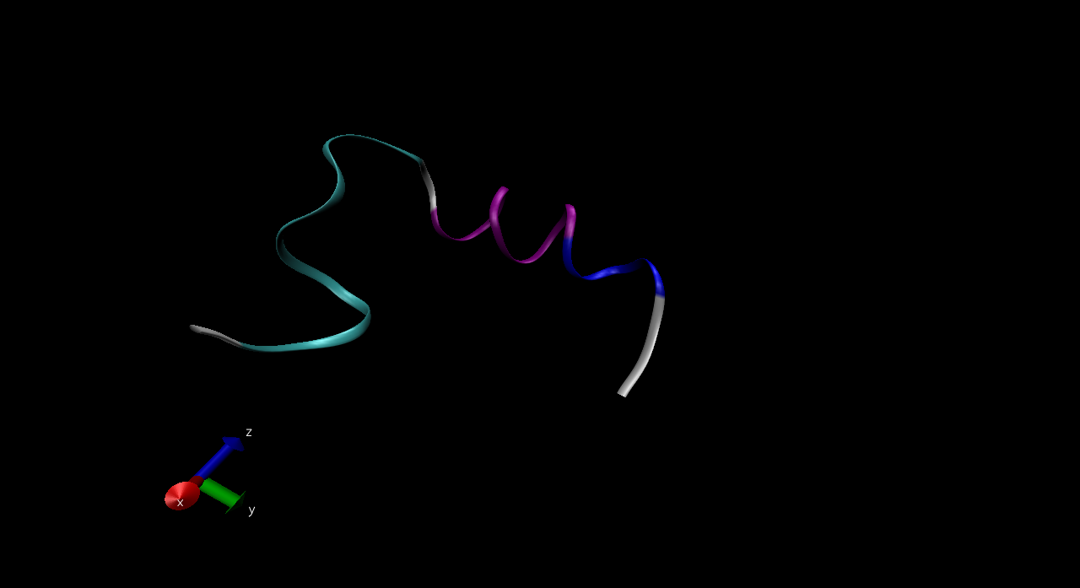
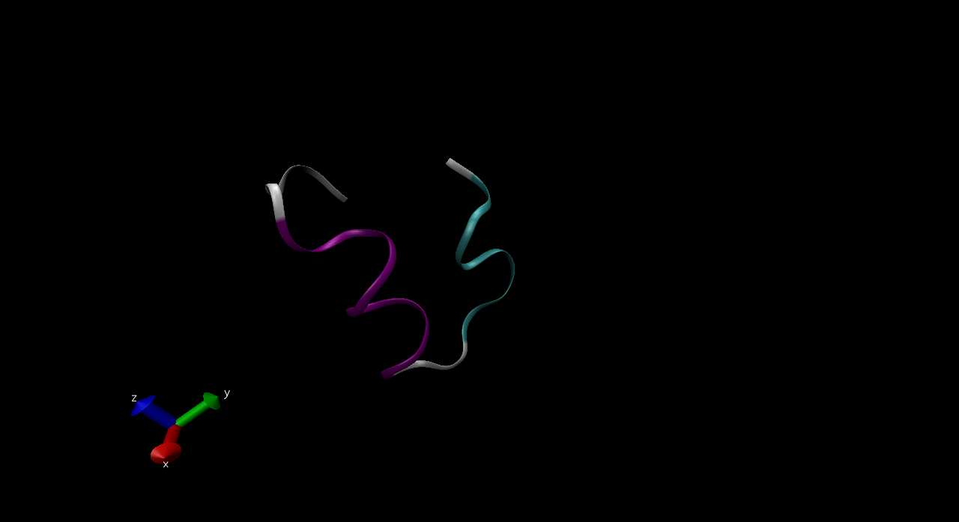
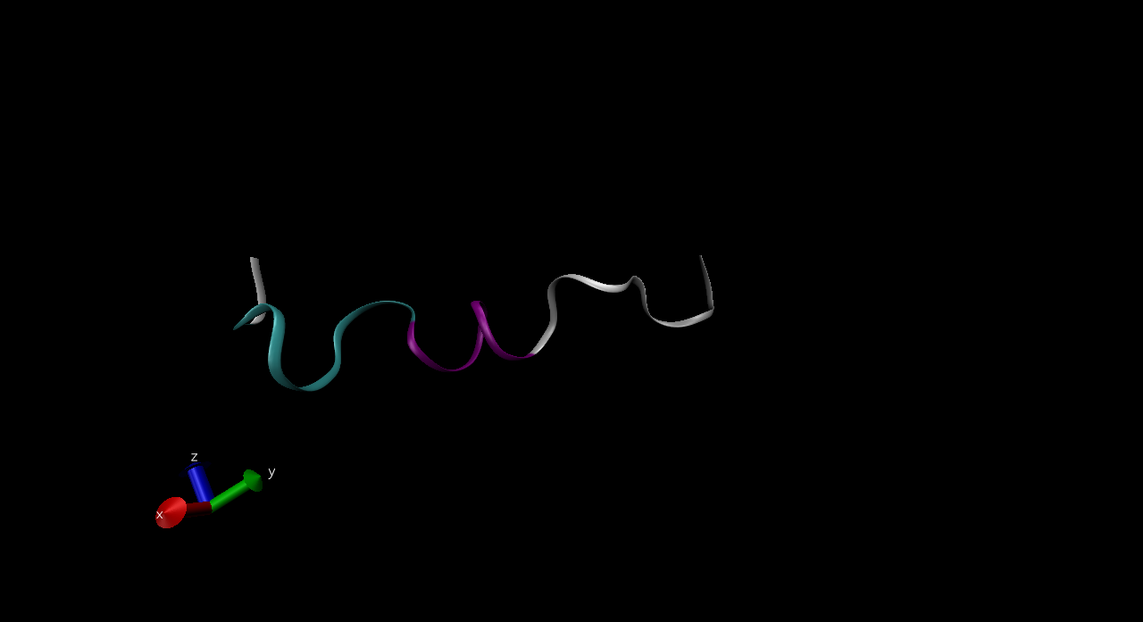
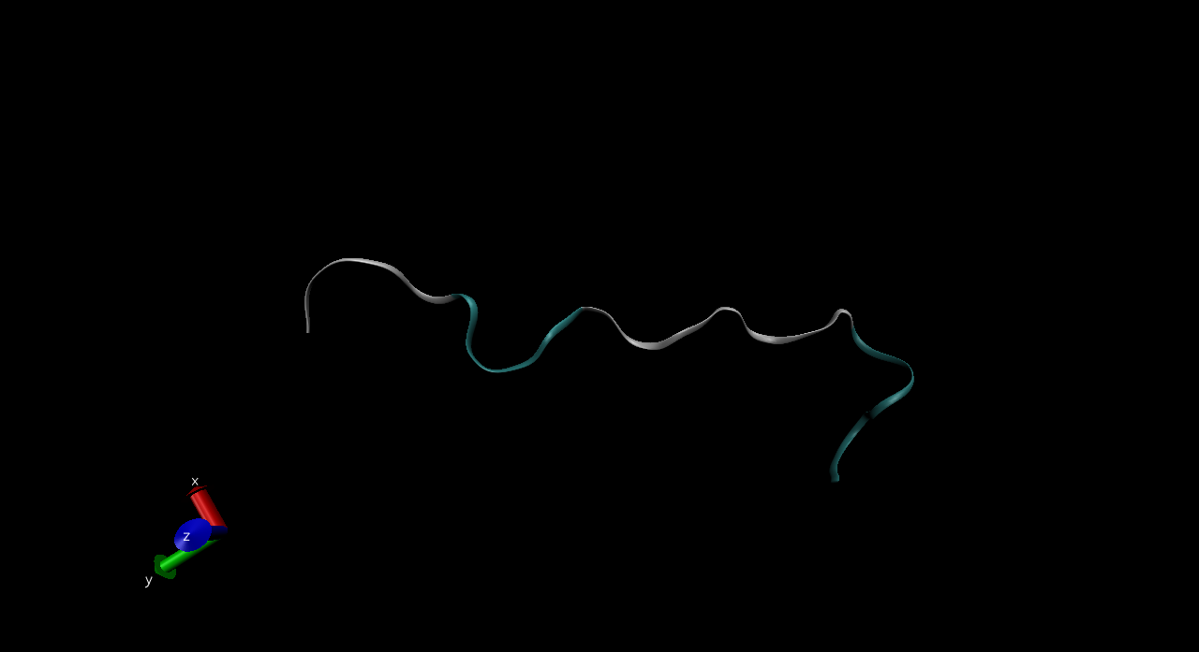
TTClust results (cont’d from VMD)

Slide 11
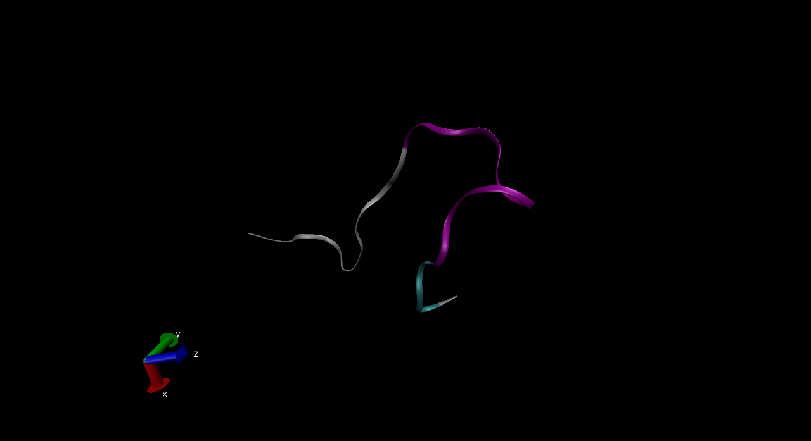
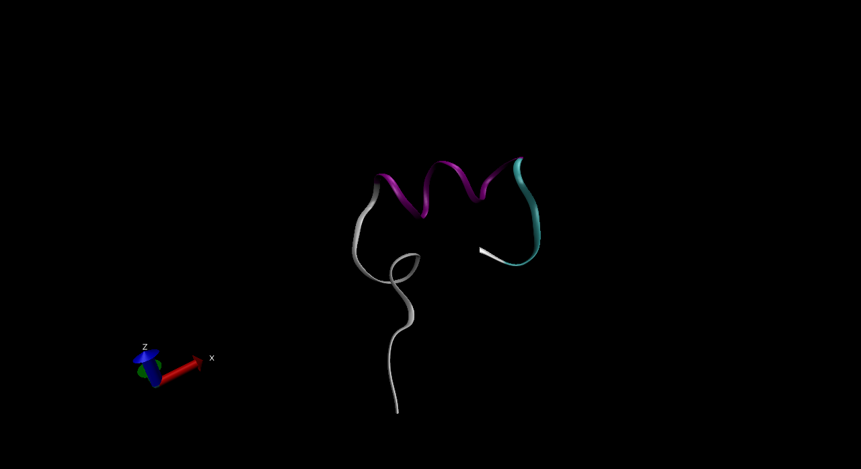
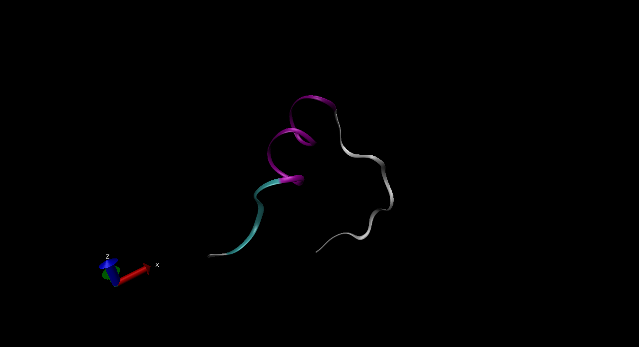
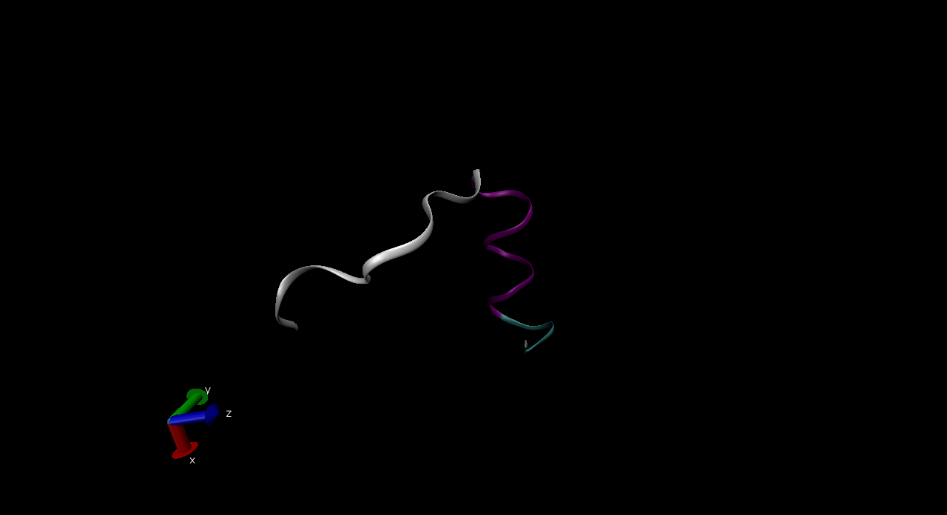
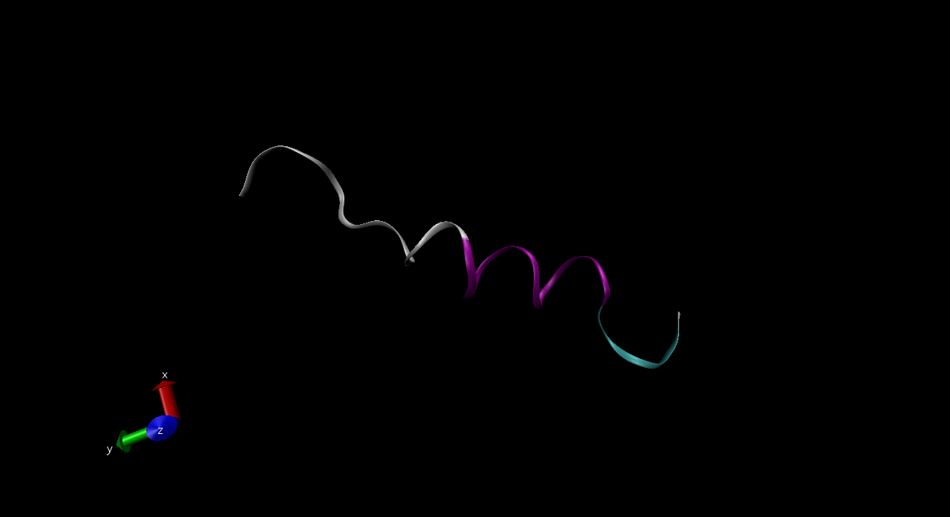
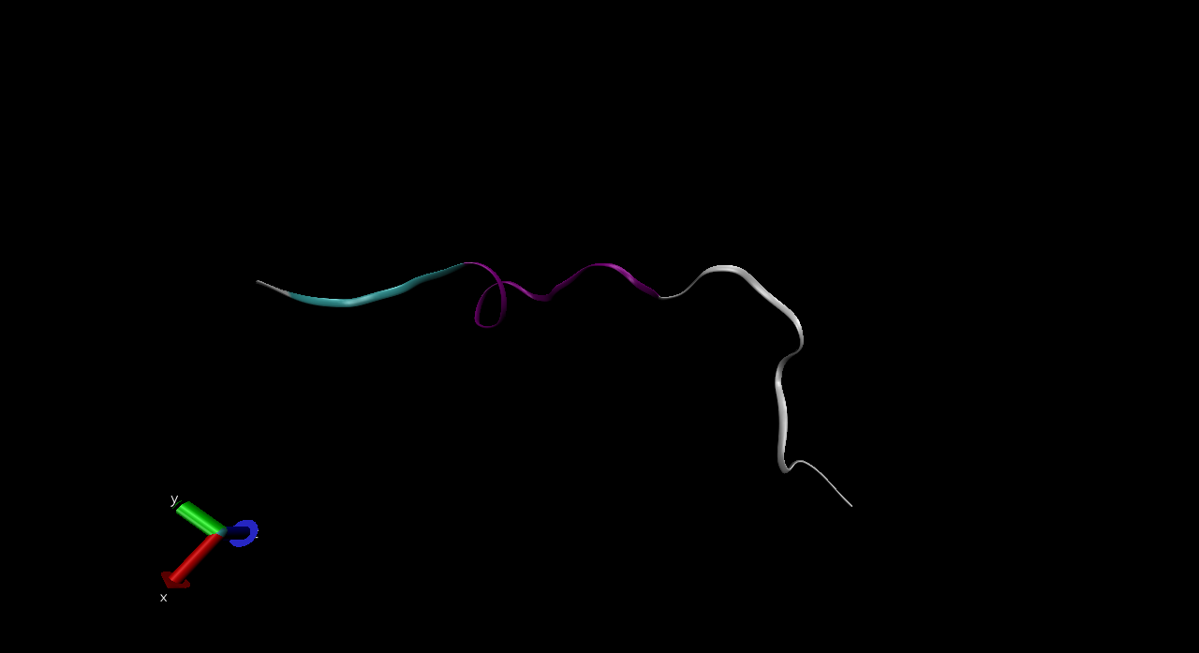
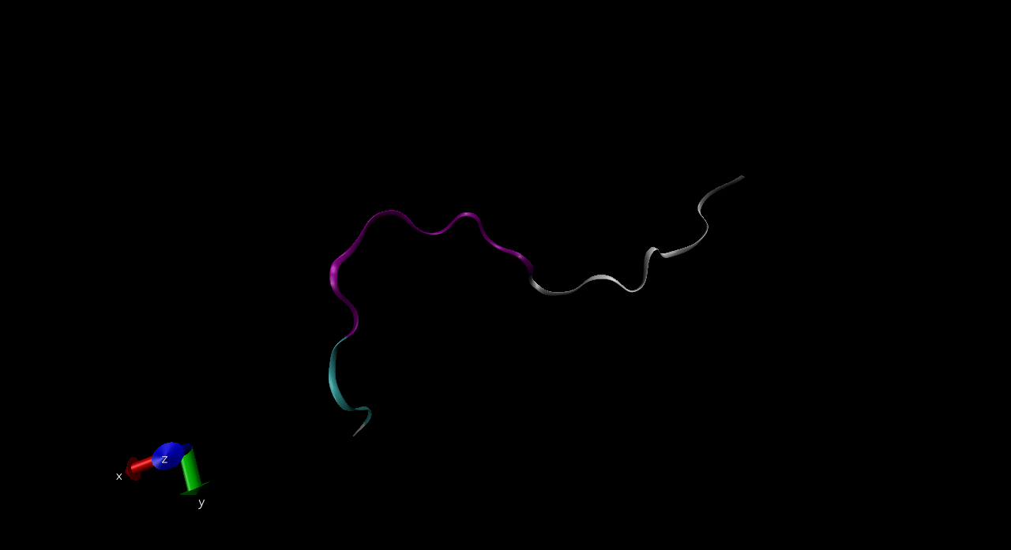
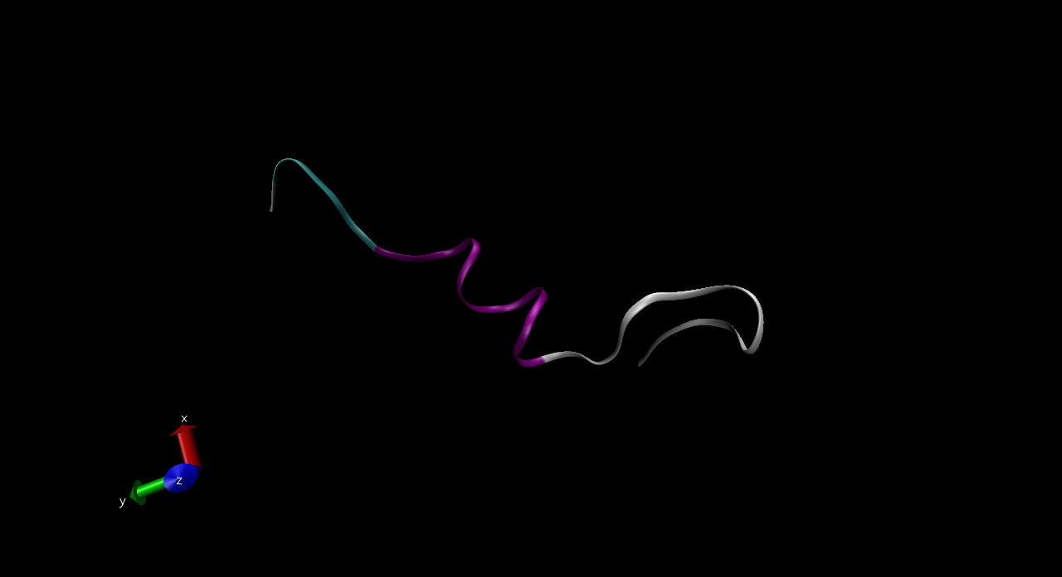
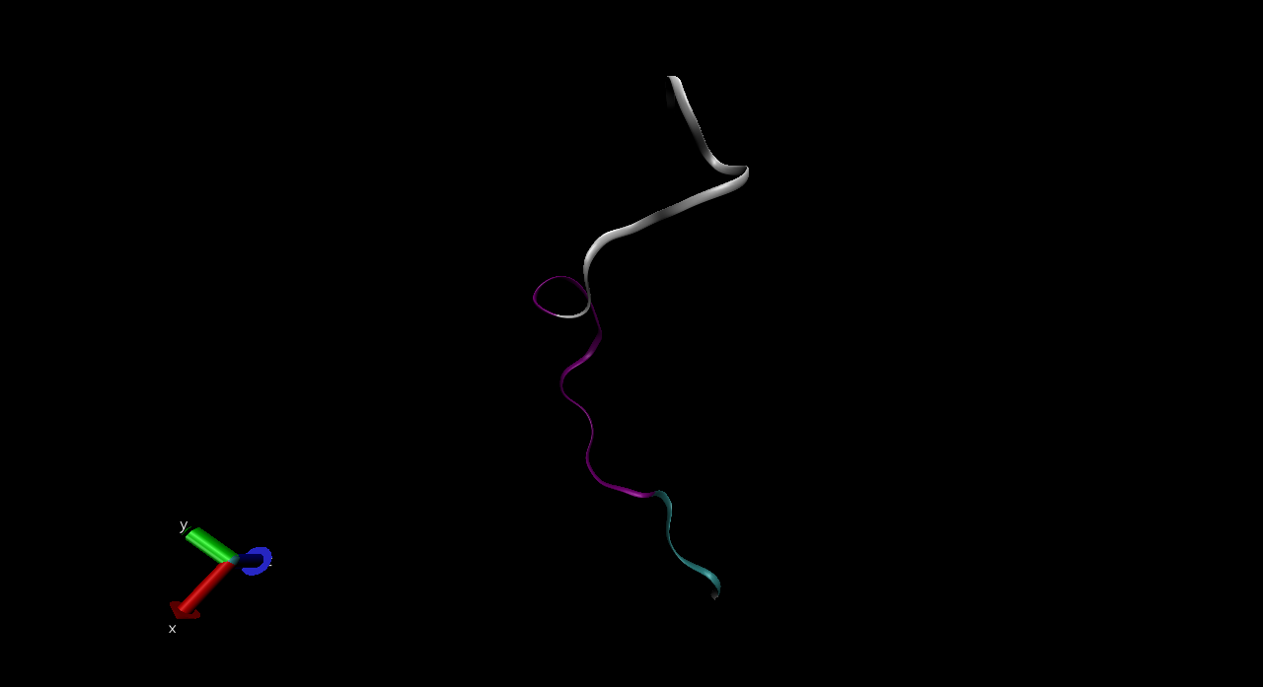
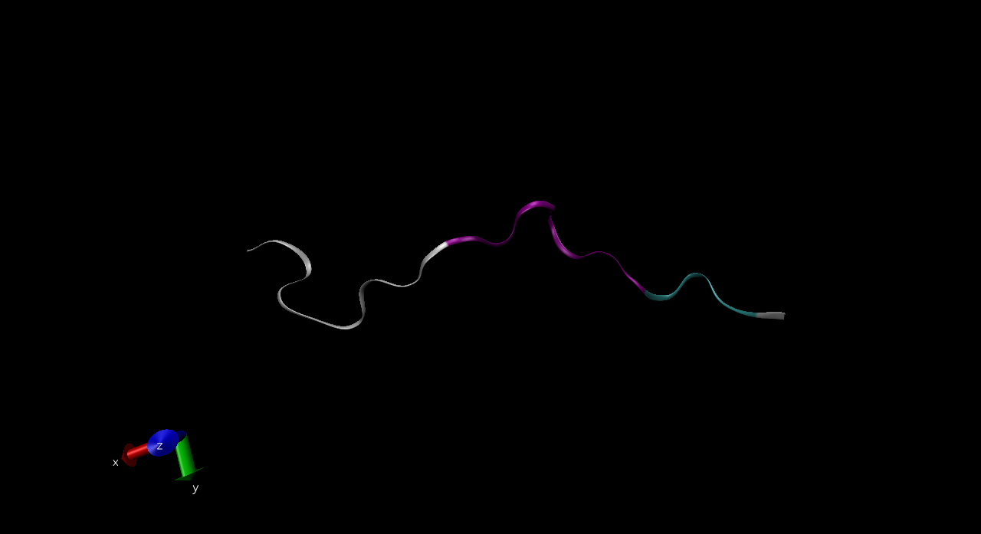
MDTraj results (from VMD)

Slide 12
Thanks!
doi.org/10.1021/acs.chemrev.0c01195
doi.org/10.1021/acs.jcim.8b00512
frontiersin.org/articles/10.3389/fmolb.2019.00046/full
github.com/tubiana/TTClust
mdtraj.org/1.9.4/examples/two-pass-clustering.html

